Slide 1

ECE INITIATIVE OF PUNJAB GOVERNMENT
&
TEACHERS’ TRAINING
By
Muhammad Shahid Saleem,
Deputy Director (Planning )
DIRECTORATE OF STAFF DEVELOPMENT (DSD), PUNJAB

Slide 2
“Investment in ECE is a commitment to Prosperous
& Bright future”

Slide 3
Policy and Sector Plans For ECE
National Education Policy (NEP) 2009
Chapter 5 on Access provides ECE for ‘broadening the base’ of learning ; and
ECE as a 2 year focus 3-5 years and state commitment for one year of ECE experience in public sector schools – Of 5 Policy Actions - 3 on Quality (pp.35-36)
National Plan of Action for EFA 2002-2015
ECE as the Third Pillar after UPE & Literacy (targeting access to 50% children)
After 18th Amendment in 2010 Education devolved entirely to the provinces – each province committed to NEP 2009

Slide 4
Policy and Sector Plans For ECE
Punjab School Education Sector Plan(PSESP)2013-2017
ECE as an area of focus
Key Strategies:
Institutionalization of ECE through development and notification of a policy
Create awareness and train education managers, head teachers and teachers on ECE
Prepare plan and implement expansion of ECE programs to 5000 primary schools every year

Slide 5
Policy and Sector Plans For ECE
Scaling Up Strategy for ECE in Punjab (2011-2021 )
  Phased Strategy- To ensure ECE resource centers are established in every public school with following components:
    Improving class room environment (development of ECE room)
    provision of learning resource material;
    Integrating ECE Teacher Training in on-going training programmes; and
    Community involvement and advocacy campaign

Slide 6
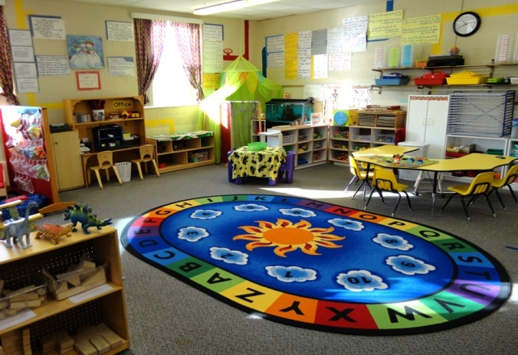
Steps Taken by Directorate of Staff
Development (DSD), Punjab
  Establishment of ECE Resource Centre at DSD Campus, Lahore
  04 ECE centers in schools in the vicinity of DSD
  (with the support of UNICEF & UNESCO)
  ECE Room in every Lab School attached with GCET
  (Total 33)
  17 ECE Rooms in Flood hit areas (M.Garh, D.G. Khan and Rajanpur Districts)
  Developed Phased Strategy to upscale ECE in Public Schools
Cont……..

Slide 7
Steps Taken by Directorate of Staff
Development (DSD), Punjab
Development of Teacher’s Guide on Early Childhood Education and Training manual
Training of 132 master trainers and 4000 teachers on ECE techniques in 2011
ECE is the part of each training conducted at DSD and in the field
In pre-service at GCETs--- B.Ed (ECE) Programme
Cont……..

Slide 8
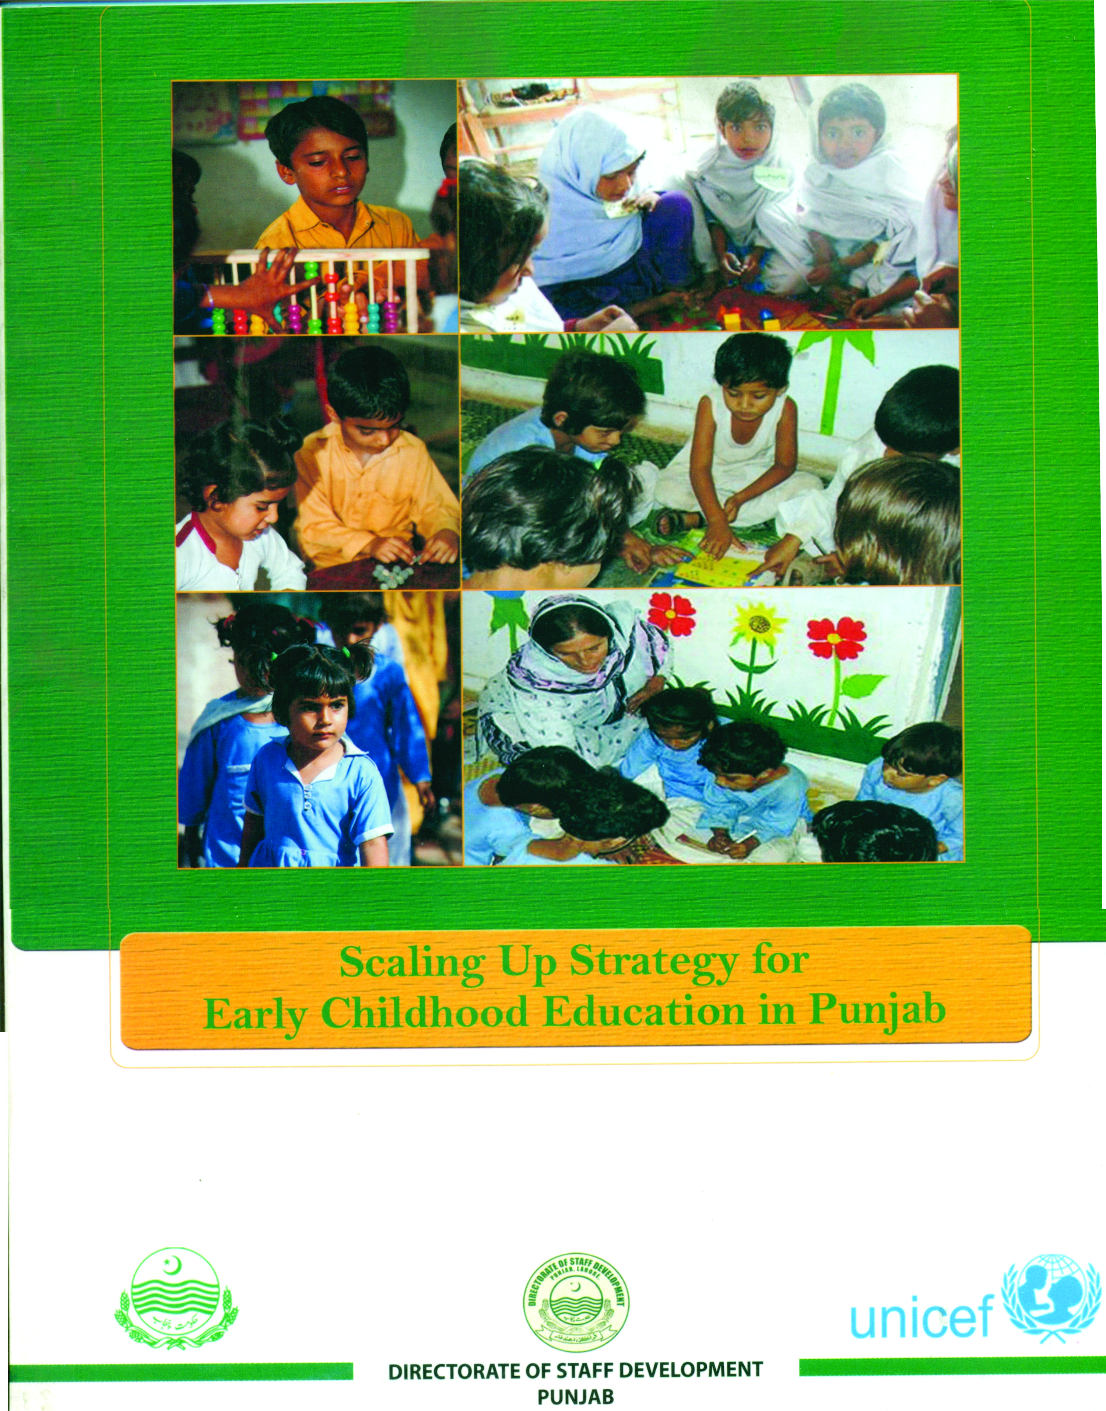
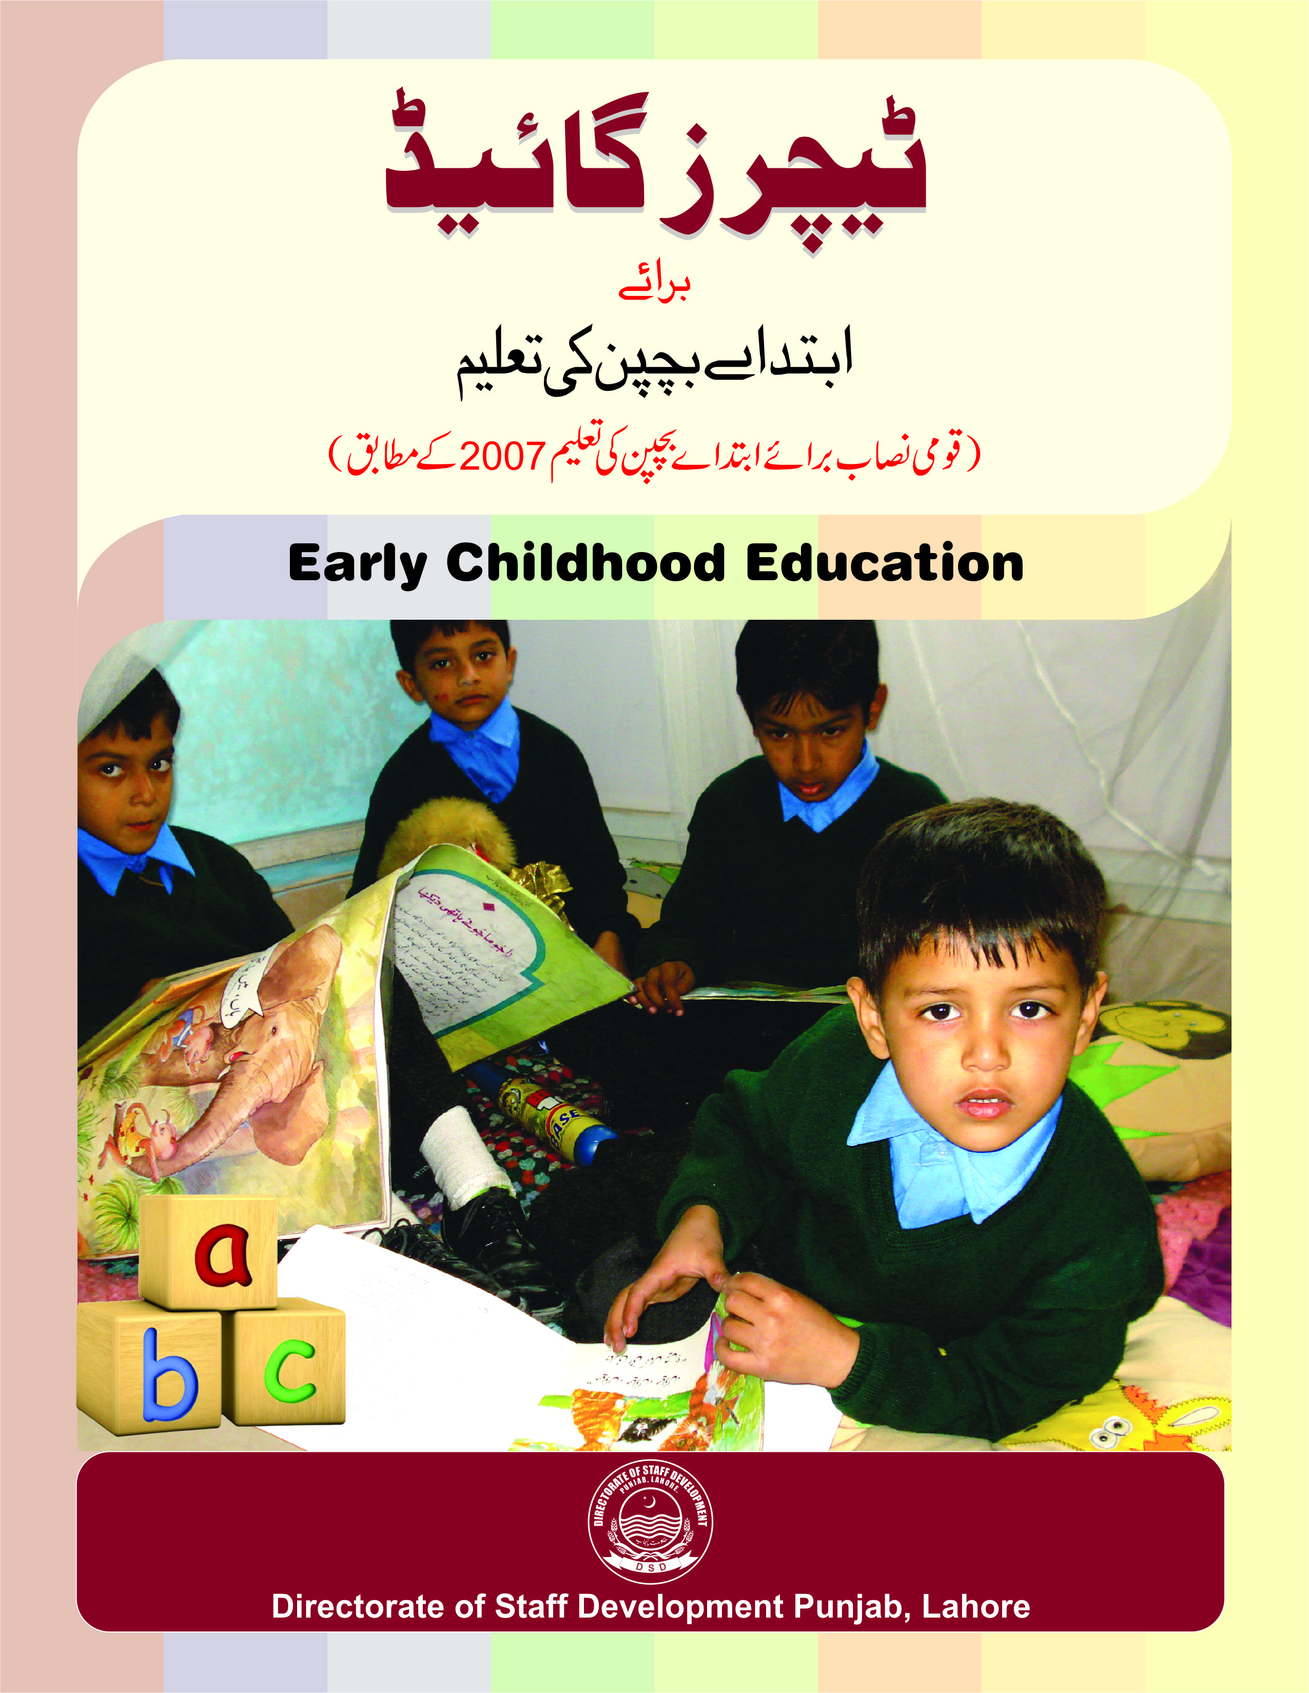
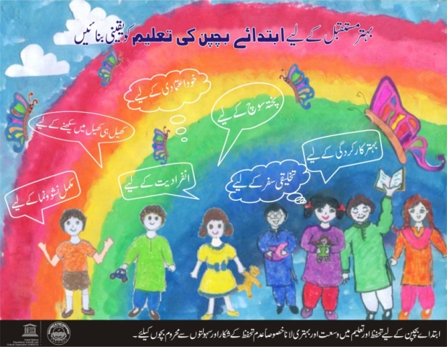

Notes:
ed

Slide 9

Project : Providing child friendly learning environment through ECE in public sector schools
  DSD has developed ECE rooms in 1,000 Primary Schools to
  provide child friendly environment to new entrants in order
  to increase enrolment and retention
Introduction of ECE in 1000 Primary Schools in Punjab (ADP Scheme)---First Phase
Total Cost: Rs. 192.602 million
Timeline : 2013-14 to 2014-15
Area : 36 Districts of Punjab

Slide 10
Providing child friendly learning environment through ECE in 1000 public sector schools
ECE Components
Learning Environment
Provision of Resource Material
Trained ECE Teachers / Care givers

Slide 11
Project : Providing child friendly learning environment through ECE in public sector schools
Master Trainers trained on ECE (70)
Training of Teachers and Head Teachers (2000)
Orientation of Members of School Councils on
ECE (3000)
Orientation of Education Managers (EDOs. DEOs, Dy. DEOs, and AEOs
Training of 1000 Caregivers (in progress)

Slide 12
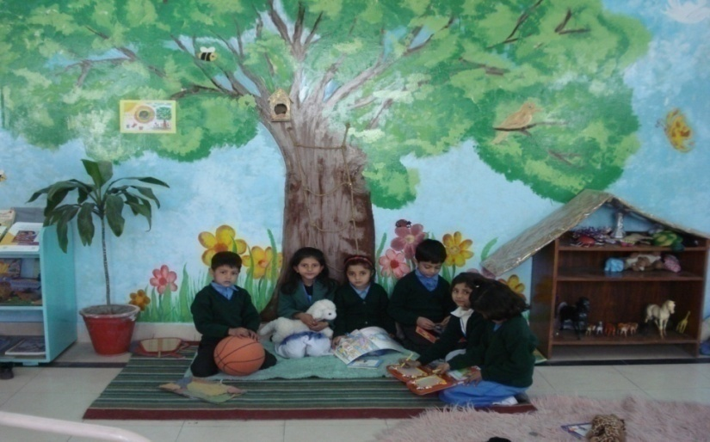
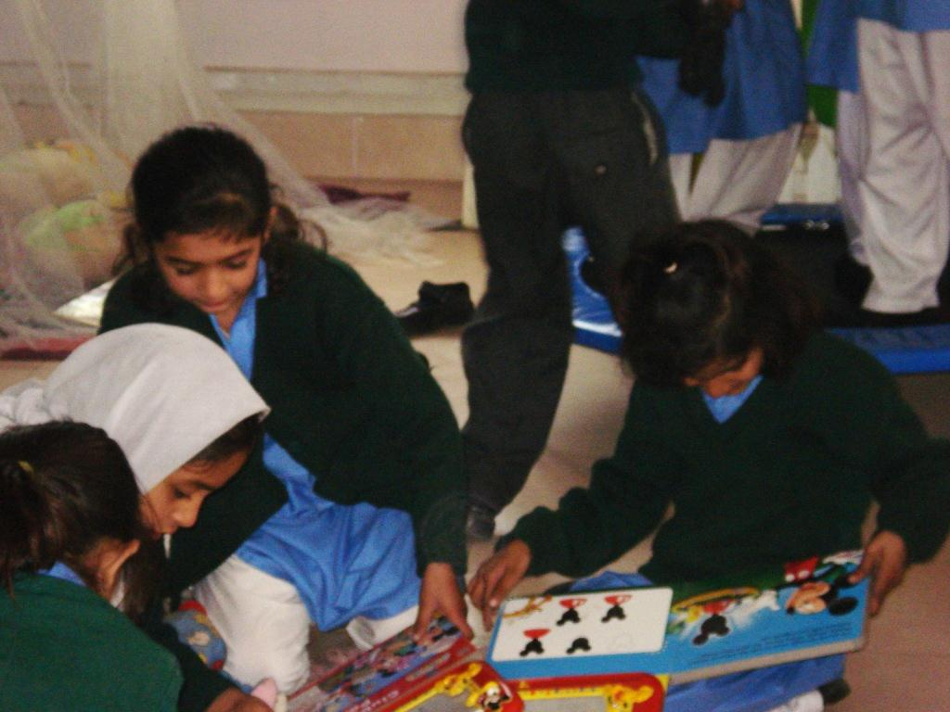
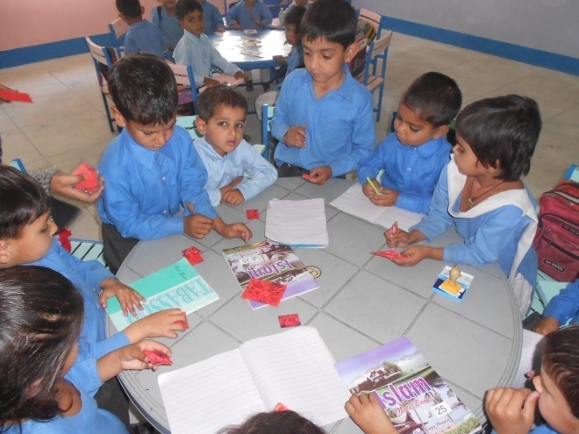
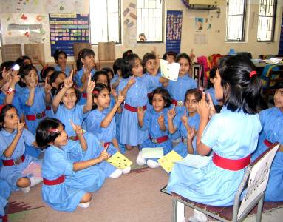
ECE Room in Lab School

Slide 13
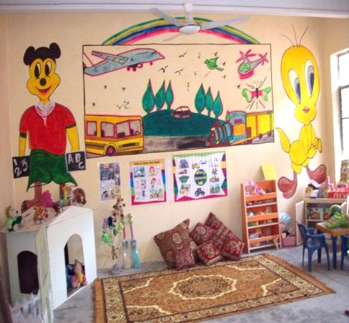
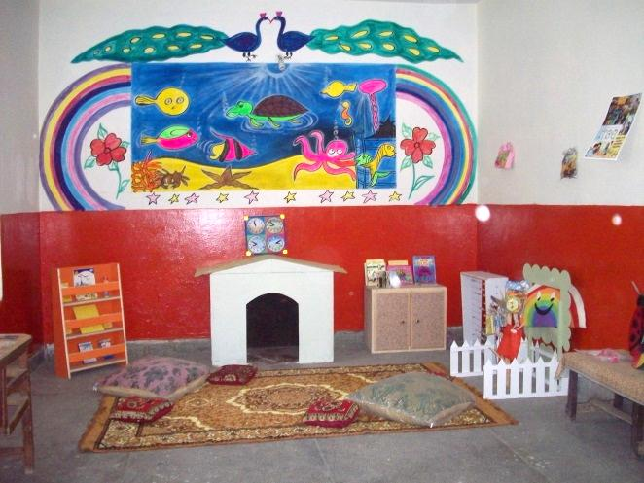
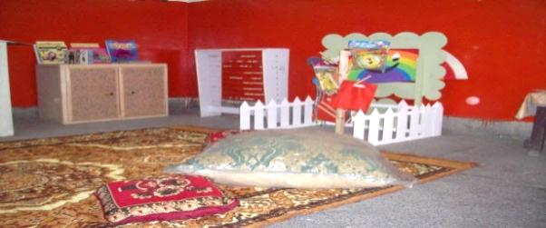
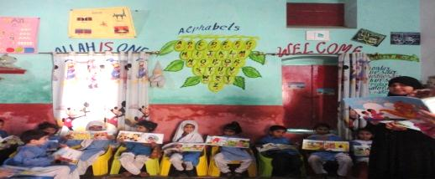
ECE Room in Primary Schools

Slide 14
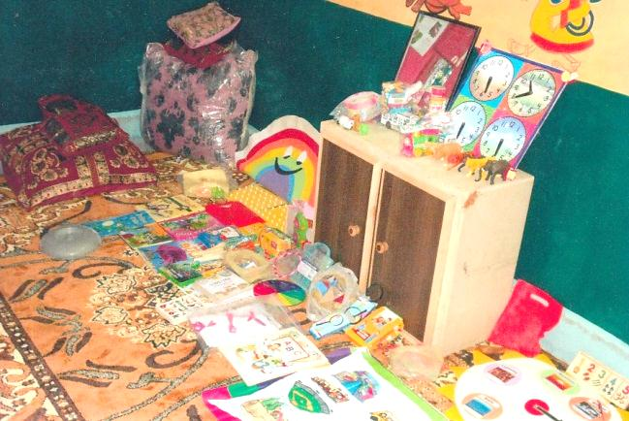
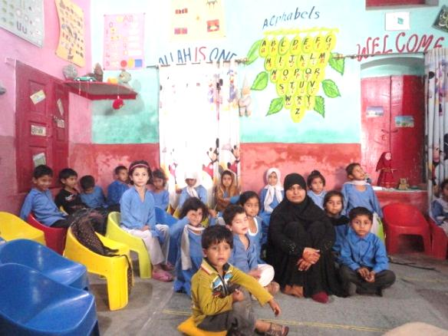
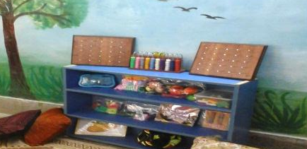
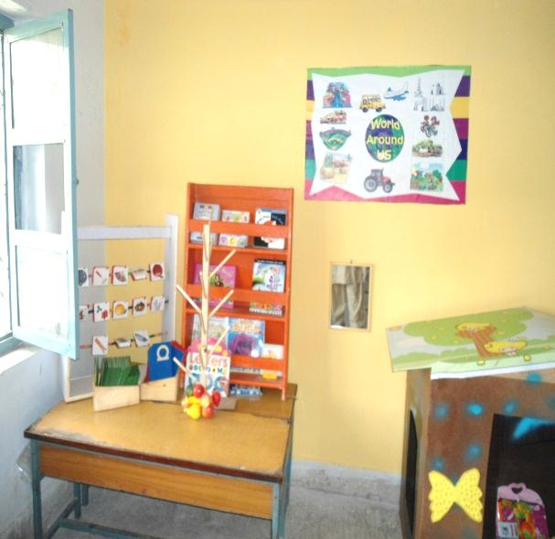
ECE Room in Primary Schools

Slide 15
Challenges
Approximately 35% drop out between ECE grade to Grade 1 is a major challenge for ECE and primary education ( Target 100% enrolled, retained & quality learning in schools)
Expansion from 3-8 to sustain pre-school and transitions to primary (Whole School approach)
Insufficient trained personnel to fully embrace ECE as a holistic program (Head teachers, teachers, field staff)

Slide 16
Continued
Lack of trained teachers with pre-service qualifications and few institutions in place for ECE pre-service
Limited resources to expand ECE in about 50,000 Schools in Punjab

Slide 17
Thank You

Slide 18
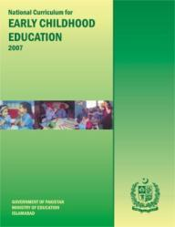
ECE Materials for Quality Learning
ECE National Curriculum 2007 – a comprehensive holistic document developed with best practitioners in the country (upgraded the 2002 document)
Developed Early Learning Development Standards (ELDS) 2009 by Ministry of Education
Training modules, ECE Teachers’ Guide for teachers and learning materials for ECE classes have been developed by DSD and distributed in 1000 schools in first phase

